Slide 1
Interpolation

Slide 2
Objective:
To study the behavior of the function through those points a technique known as interpolation is introduced.
Methodologies:
Two methods can be used for interpolation. They are
1. Newton’s divided difference interpolation
2. Lagrange Interpolating Polynomial

Slide 3
Newton’s divided difference interpolation

Slide 5

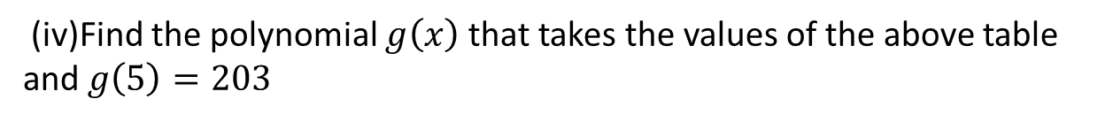
Example
The table below gives the values of x and f(x):
x : | −1 | 1 | 2 | 3 | 4
f(x) : | −7 | −1 | 8 | 29 | 68
(i) Construct a divided-difference table for the above data.
(ii) Find the polynomial of least degree that incorporates the values in the table and find $f(5)$
(iii) Find by linear interpolation a real root of $f\left(x\right)=0$
(iv)Find the polynomial $g\left(x\right)$ that takes the values of the above table and $g\left(5\right)=203$

Slide 6
Solution
(i)The divided difference table for the given data is as follows:
x | f(x) | f¹[ ] | f²[ ] | f³[ ] | f⁴[ ]
-1 | -7
1 | -1 | 3
2 | 8 | 9 | 2
3 | 29 | 21 | 6 | 1
4 | 68 | 39 | 9 | 1 | 0

Slide 7
(ii) The needed differences are enclosed by the double lined box.
By Newton’s divided difference formula, we get

Slide 9
Advantages and Drawbacks:
Newton divided difference interpolation
Advantages of Newton divided difference interpolation:
Higher-order polynomials can exactly fit larger datasets (by construction).
They are simpler to evaluate than non-polynomial approximations.
Drawbacks of Newton divided difference interpolation
Because of their rigidity (due to smoothness), they tend to over-fit the data.
This over-fitting is a serious issue, which is why it is often much better to use a spline, i.e., a collection of polynomials stitched together

Slide 10
Lagrange Interpolating Polynomial

Slide 12
Example
The following table gives the values of an empirical function
x | 0 | 1 | 2 | 3
f(x) | −4 | −1 | 8 | 29
(i) Use the Lagrange interpolation formula to estimate $f(2.5)$
(ii) the root of the equation $f\left(x\right)=0 \text{to}\text{ 3 }\text{decimal} \text{places}$
Solution:
(i) Applying Lagrange’s formula, we have

Slide 13
y | −4 | −1 | 8 | 29
x | 0 | 1 | 2 | 3

Slide 15
Advantages and Drawbacks: Lagrange Interpolation
Advantages of Lagrange Interpolation
The answers for Higher-order polynomials will be more accurate.
For Higher-order polynomials the approximate result convergesmto the exact solution very quickly.
Drawbacks of Lagrange interpolation
It becomes a tedious job to do when the polynomial order increases the number of point increases and we need to evaluate approximate solutions for each point.
15

Slide 16
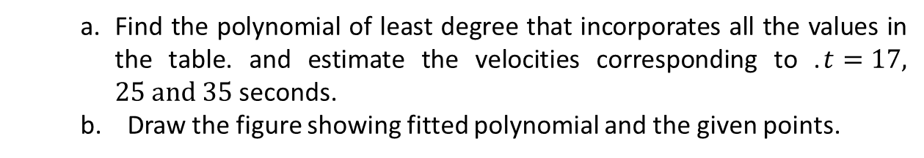
MATLAB CODE
Write down MATLAB codes using “polyfit(x, y, n)” and “polyval(p, x)” for the following.
t (s) | 10 | 15 | 20 | 22.5 | 30
v(t) (m/s) | 227 | 363 | 517 | 603 | 903
a. Find the polynomial of least degree that incorporates all the values in the table. and estimate the velocities corresponding to .$t=17, 25 and 35$ seconds.
b. Draw the figure showing fitted polynomial and the given points.
a) >> t=[10 15 20 22.5 30];
>> v=[227 363 517 603 903];
>> pt=polyfit(t,v,4)
pt = -0.0002 0.0240 -0.4267 28.2000 -34.2000
>> t1=[17 25 30];
>> v1=polyval(pt,t1);
>> % Output value of v for t
>> t_v =[t1',v1']
t_v = 17.0000 421.9875
25.0000 695.8000
30.0000 903.0000
b)

Slide 17
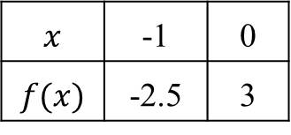
SAMPLE MCQ
1. To study the behavior of the function through only a few discrete sets of values points a technique known as
Curve fitting, (b) Interpolation, (c)Trapezoidal Rule, (d) None
2. By inverse Lagrange method find the real root for $f\left(x\right)=0$from the sets of data:
$$x$$ | -1 | 0
$$f(x)$$ | -2.5 | 3
0.45,
-0.54,
-1,
2.
3. What is the MATLAB command for finding polynomial from some discrete sets of values.
(a) polyal(x,y,x0) , (b) polyfit(x,y,n) , (c) Both, (d) None.

Slide 18
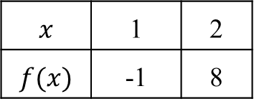
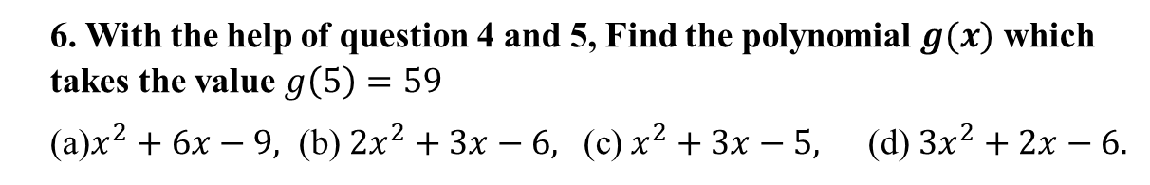
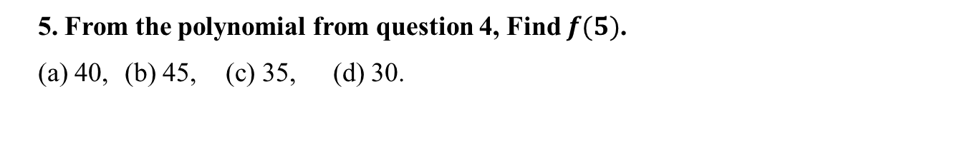
4. By Newtons Divided Difference method find the polynomial from the data:
$$x$$ | 1 | 2
$$f(x)$$ | -1 | 8
(a) $9x−1$ (b)$10x−9,$ (c)$9x−10,$ (d)$x−9,$
5. From the polynomial from question 4, Find $f(5)$.
(a) 40, (b) 45, (c) 35, (d) 30.
6. With the help of question 4 and 5, Find the polynomial $g(x)$ which takes the value $g\left(5\right)=59$
(a)$x^{2}+6x−9,$ (b) $2x^{2}+3x−6,$ (c)$x^{2}+3x−5,$ (d)$3x^{2}+2x−6.$

Slide 19

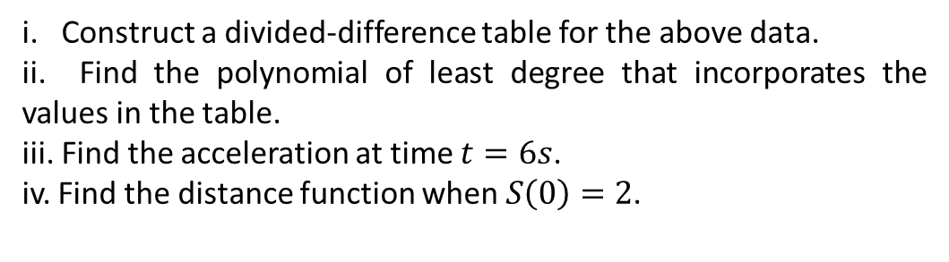
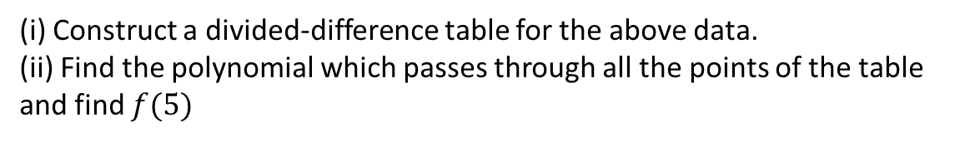
Exercises
1. The table below gives the velocity v at time t
t(s) | 1 | 3 | 4 | 7
v(m/s) | 3 | 5 | 21 | 201
i. Construct a divided-difference table for the above data.
ii. Find the polynomial of least degree that incorporates the values in the table.
iii. Find the acceleration at time $t=6s$.
iv. Find the distance function when $S\left(0\right)=2$.
2. The table below gives the values of $x and f(x)$
x | -2 | 0 | 3 | 6 | 7
f(x) | 2 | -4 | -58 | 842 | 1802
(i) Construct a divided-difference table for the above data.
(ii) Find the polynomial which passes through all the points of the table and find $f(5)$
(iii) Find the polynomial $f\left(5\right)$ that takes the values of the above table and $g\left(5\right)=549$

Slide 20

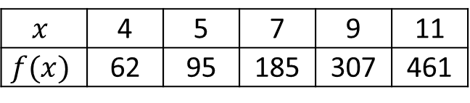
3. The table below gives the values of $x and f(x)$
$$x$$ | 4 | 5 | 7 | 9 | 11
$$f(x)$$ | 62 | 95 | 185 | 307 | 461
i. Construct a divided-difference table for the above data.
ii. Find the polynomial which passes through all the points of the table and find f(12).
iii.Find the polynomial g(x) that takes the values of the above table and g (12)=1280.
iv. Use Lagrange interpolating polynomial to estimate
a. The value of f(8 )using two points.
b. The value of x for f(x)=380 using three points.
v. Write down MATLAB codes using “polyfit(x, y, n)” and “polyval(p, x)” for the following.
vi. Find the polynomial of least degree that incorporates all the values in the table and estimate the values corresponding to x=1, 3 and 5

Slide 21
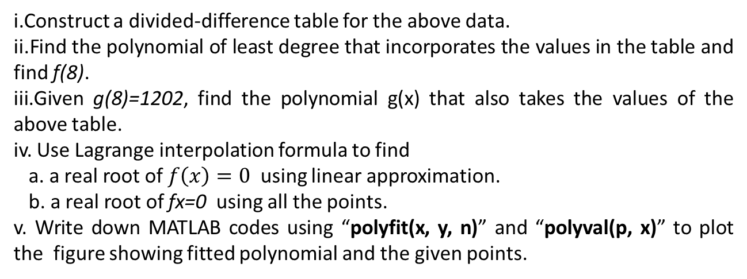
4. The table below gives the values of x and f(x):
x | -2 | -1 | 0 | 3
f(x) | 12 | 14 | 10 | 22
i.Construct a divided-difference table for the above data.
ii.Find the polynomial of least degree that incorporates the values in the table and find f(8).
iii.Given g(8)=1202, find the polynomial g(x) that also takes the values of the above table.
iv. Use Lagrange interpolation formula to find
a. a real root of $f\left(x\right)=0$ using linear approximation.
b. a real root of fx=0 using all the points.
v. Write down MATLAB codes using “polyfit(x, y, n)” and “polyval(p, x)” to plot the figure showing fitted polynomial and the given points.

